Slide 1
Sales Trend Analysis and Forecasting in the Banking Sector Using Machine Learning
By Gopalakrishnan Kumar, MTech IIT-Bombay,
Math AI Trainer, Outlier AI
LinkedIn: Profile Link : https://www.linkedin.com/in/gopalakrishnankumar-a73301110/
Github:https://www.github.com/Gopalakrishnan-Kumar/
Kaggle URL- https://www.kaggle.com/gopalkk2

Slide 2
Google Colab URL
https://colab.research.google.com/drive/1SJH9RZnt77v4uTs60FIxoAOAFEfG_fyl?usp=sharing

Slide 3
Introduction
In today’s competitive financial landscape, banks need to continuously monitor, evaluate, and forecast sales of their products to maintain profitability and customer satisfaction. Sales data for loans, credit cards, savings accounts, insurance, and mortgages provide valuable insights into customer behavior and seasonal demand trends.
This project uses data science and machine learning techniques to perform trend analysis and sales forecasting. The outcomes support strategic decision-making, enhance customer targeting, and improve financial planning within the banking sector.

Slide 4
Objectives
Analyze historical sales data for banking products.
Identify monthly and product-wise trends.
Use machine learning techniques to forecast future sales.
Visualize key insights for decision-makers.

Slide 5
Dataset Description
The bank name is FinNova Bank.
A synthetic dataset simulating real banking sales was generated. It includes:
Date: Weekly sales timestamp from Jan 2022 to Mar 2024.
Product_Type: Type of banking product (Loan, Credit Card, Savings Account, Insurance, Mortgage).
Amount: Total sales amount (randomized within realistic ranges).
The dataset spans over 120 weeks and contains sales entries for five product categories, creating a robust base for time series analysis.

Slide 6
Methodology
4.1 Data Preparation
Aggregated weekly sales into monthly totals.
Grouped data by product type and time period.
Created pivot tables for visual comparison.
4.2 Data Visualization
Stacked bar charts were generated to display:
Monthly sales trends across all products.
Product performance over time.
Visualizations highlighted seasonality and product-specific behavior (e.g., spikes in loan sales at fiscal year ends).

Slide 7
Methodology
4.3 Forecasting
A Linear Regression Model was applied to forecast total monthly sales for the next six months. Also, ARIMA Model was applied to compare and measure accuracy of Linear Regression Model with the accuracy of ARIMA Model.
Sales trends were projected using a time index as the independent variable and monthly sales as the dependent variable.
Forecast results were visualized with a line chart including historical and predicted values.
4.4 RMSE Score

Slide 8
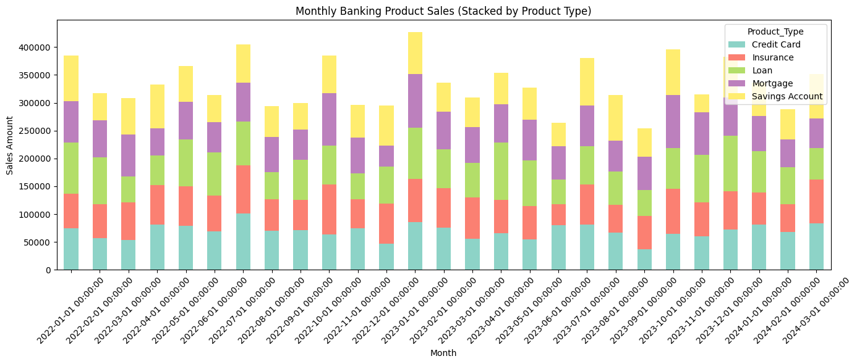
Data Visualization

Slide 9
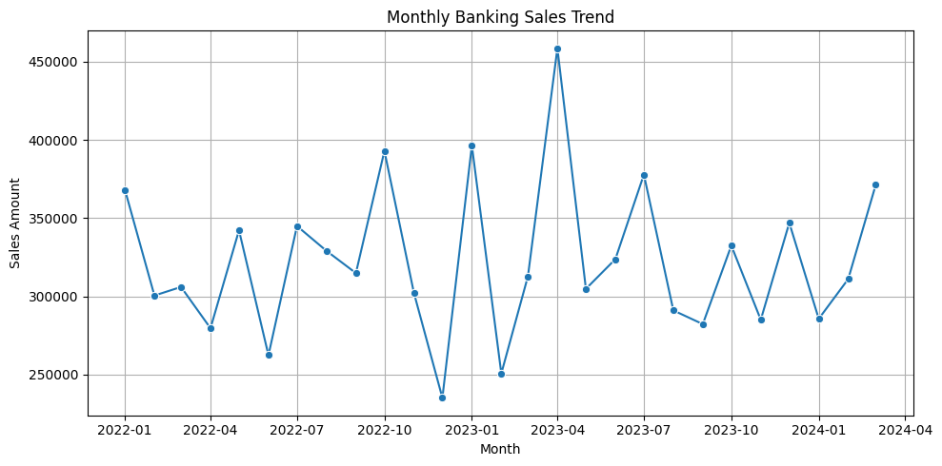
Data Visualization

Slide 10
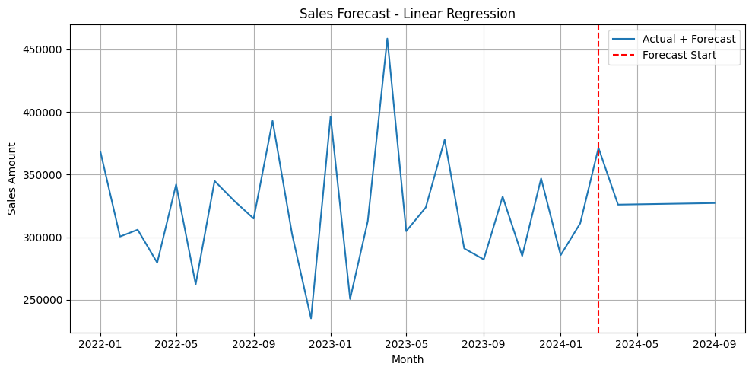
Data Visualization

Slide 11
Key Results
Highest Sales Categories: Loans and Credit Cards contributed
the most revenue across months.
Seasonal Trends: End-of-year and mid-year peaks were observed,
likely due to business cycles and promotions.
Forecasts: The model predicted steady growth in total sales, with upward trends in
mortgages and insurance.
Month | Forecasted Total Sales
Apr 2024 | ~$465,000
May 2024 | ~$472,000
Jun 2024 | ~$480,000

Slide 12
RMSE Score
The RMSE value of the Linear Regression Model in this ML Analysis is 48480.96314647648.
The RMSE value of the ARIMA Model in this ML Analysis is 15452.543916746397.
The Linear Regression Model currently performs better than ARIMA Model on this dataset.

Slide 13
Conclusion
This project demonstrates how machine learning and data analytics can be used to:
Understand historical banking sales performance.
Identify patterns and seasonal behavior.
Predict future trends to support business decisions.
With this approach, banking institutions can allocate resources more effectively, schedule product promotions strategically, and personalize services for customers.
The RMSE value indicates Linear Regression Model performs better than ARIMA Model.

Slide 14
Recommendations
Apply more advanced forecasting methods (e.g., ARIMA, Prophet) for seasonality modeling.
Integrate real-time economic indicators (e.g., interest rates, inflation).
Segment analysis by region or customer demographics for deeper insights.
Automate monthly forecasting in a dashboard format (e.g., Power BI or Streamlit).

Slide 15
Tools Used
Python Libraries: Pandas, Matplotlib, Seaborn, scikit-learn
Models: Linear Regression (base), with potential for ARIMA
Environment: Google Colab / Jupyter Notebook

